Slide 1
Human Action Recognition Under View Change
Under the Guidance of
Dr.Shiloah Elizebeth
Prepared By
Group Name:msmgp
Murugappan N
Maaniccka Sentil Ma P
Mohamed Shamsudeen G

Slide 2
Project Abstract
An automated visual surveillance system is used to detect abnormal behavior patterns and recognize the normal ones.
If a person enters a room, video of him/her is captured and stored(both side view and the top view) then it is given to the training module here the video is checked if it is a normal behavior splited image is taken, whenever the action is recognized blob images are saved, and the frame counts are taken .
In case, the anomaly is detected the red color will be displayed. The abnormal behavior is achieved by keep tracking the videos and blob frames and checking each frame values.
The normality and abnormality of the captured motion is ascertained by checking the System for valid and invalid behavior. This involves training the module in the beginning for valid behavior by the controller.

Slide 3
Introduction
Visual recognition and understanding of human actions have attracted much attention over the past three decades and remain an active research area of computer vision
A good solution to the problem holds a yet unexplored potential for many applications, such as the search for and the structuring of large video archives, video surveillance, human-computer interaction, gesture recognition.
Recent work has demonstrated the difficulty of the problem associated with the large variation of human action data due to the following reasons
  Varied Posture and motion
  Individual variations of people in expression
  Perspective effects, camera motions and illumination variations
  Distracting effects of scenes surroundings.

Slide 4
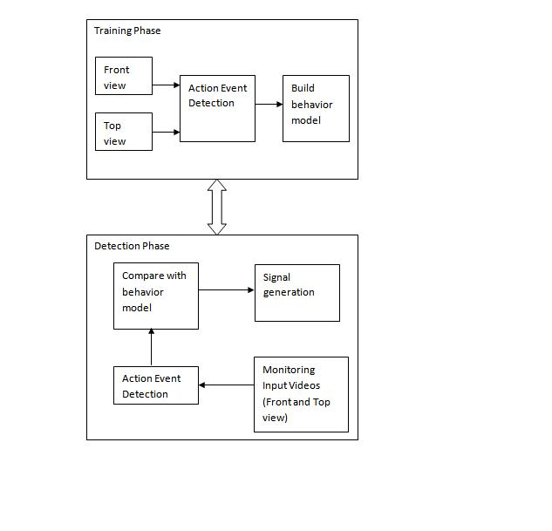
Introduction to Training and
Detection Phase

Slide 5
Literature Survey
IEEE Reference Details:
This paper appeared in: Pattern Analysis and Machine Intelligence, IEEE Transactions on TITLE: VIEW-INDEPENDENT ACTION RECOGNITION FROM TEMPORAL SELF-SIMILARITIES
The project propose a self-similarity-based descriptor for view independent video analysis, with human action recognition as a central application.
Self-similarity being possibly defined over a variety of image features, either static (histograms of intensity gradient directions) or dynamic (optical flows or point trajectories), these descriptors can take different form and can be combined for increased Descriptive power.
Experimental validation on action recognition, as well as for the different problem of action synchronization, clearly confirms the stability of this type of description with respect to view variations.

Slide 6
IEEE REFERENCE DETAILS:
  TITLE:THE RECOGNITION OF HUMAN MOVEMENT USING TEMPORAL TEMPLATES
  A new view-based approach to the representation and recognition of human movement is presented. The basis of the representation is a temporal template-a static vector-image where the vector value at each point is a function of the motion properties at the corresponding spatial location in an image sequence
  Then a recognition method matching temporal templates against stored instances of views of known actions is developed. The method automatically performs temporal segmentation, is invariant to linear changes in speed, and runs in real-time on standard platforms.
  It is in contrast to many recent efforts to recover the full three- dimensional reconstruction of the human form from image sequences, instead a view-based approach is developed to the representation and recognition of movement that is designed to support the direct recognition of the motion itself.
  Human Action Recognition Under View Change concentrates on the matching pattern of the human behaviour and can be used as a real time application.

Slide 7
IEEE REFERENCE DETAILS:
TITLE: A SURVEY OF ADVANCES IN VISION-BASED HUMAN MOTION CAPTURE AND ANALYSIS.
The current scene is interpreted correctly from the front angle and tracking humans from the scene in one or more frames is done.
It involves the analysis of the new patterns and makes a match with the pre defined stored patterns.
The paper concentrates only on the front view which may be a disadvantage in some cases as Top view is also needed to be tracked.
Human Action Recognition Under View Change concentrates on both top and front angle for better precision and accuracy in tracking.

Slide 8
IEEE REFERENCE DETAILS:
TITLE: RECENT DEVELOPMENTS IN HUMAN MOTION ANALYSIS:
The above reference project concentrates on the human action and motion tracking and studying various behaviors of the human action.
Human Action Under View Change elaborates the behavioral pattern and also stores it.
It makes a match with the predefined pattern and produces a siren when mismatch occurs.
It can also be used at any location or at any organization and it is a real time application.

Slide 9
Existing System
Existing System is based on the assumption that there exist well defined and known a priori behavior classes both normal and abnormal thus reduces the chance of finding
In reality abnormal behavior is both rare and far from being well defined resulting in insufficient clearly labeled. Date required for supervised model building. It performs clustering on observed patterns and labels those forming small clusters as being abnormal or builds a system of spatiotemporal patches using only regular Normal behavior and detect those patterns that cannot be composed from the system as being abnormal
Disadvantages:
Cannot be used for a dynamic environment where every valid visitor cannot be known before building the system
Higher Cost involved due to lack of unsupervised Learning.

Slide 10
Proposed System
  Proposed System is based on unsupervised behavior profiling. The framework’s components are :
A scene event-based behavior representation.
Behavior profiling and pattern matching done to ensure security.
Quick Anomaly detection .
Dynamic in nature and adaptable to the given environment.
Advantages :
It is fully unsupervised that manual interpretation is avoided.
It is more robust and thus able to work effectively even with sparse and noisy data.
It is superior in detecting anomaly from an unseen video.
Each blob with an average PCH value greater than a threshold is defined as a scene event.

Slide 11
VIDEO BEHAVIOR PROFILING FOR ANOMALY DETECTION
TRAINING PHASE
CAPTURE VIDEO
DIVIDE VIDEO INTO FRAMES
DETECT EVENT IN EACH FRAMES
IF EVENT
ALREADY
EXISTS
YES
NO
INCREMENT
OCCURENCE
STORE EVENT
SELECT NEXTFRAME
SELECT FREQUENTLY OCCURING EVENTS
BUILD BEHAVIOUR MOBEL

Slide 12
DETECTING PHASE
CAPTURE MONITORING DATA
DIVIDE INTO VIDEO FRAMES
CHECK
EVENT EXISTS IN BEHAVOUR MODEL
NO
YES
RECOGNIZE EVENT
AS ANOMALY
RECOGNIZE EVENT
AS NORMAL
SIGNAL TO ADMIN

Slide 13
MODULES
List of various Modules Integrated into the proposed System:
Video Segmentation
Event Based Behavior Representation
Anomaly Detection
Alert System

Slide 14
VIDEO SEGMENTATION
Video Segmentation involves spitting the input video from the surveillance camera into various sequence of frames with help of Java Media Framework.
Video can be simply sliced into overlapping segments with a fixed time duration.
EVENT BASED BEHAVIOR REPRESENTATION
Identify the foreground and background pixel of a frame.
Background model stores the values of a particular pixel which corresponds to background colors.
Pixel change history(PCH) is represented for a pixel.
Similar foreground pixels are grouped to form a blob.
A behavior pattern is represented as a sequence of various events.

Slide 15
ANOMALY DETECTION SYSTEM
The video to be detected is divided into segment
Each segment is divided into frames
Event is detected for each frames
If event not exists already in training video, it is considered as an anomaly
ALERT SYSTEM
When the system detects an anomaly an unauthorized person enters the room and immediately this alert is sent to the Admin/Controller of the system.
The alert system may also be extended by sending SMS to the controller if he is not available.

Slide 16
Module Split-up
(among Team Mates)
Murugappan :
Developing Video Segmentation
Formation and storage of the BLOB image
Front End Designing.
Maaniccka Sentil:
Build training data set
Behavior Analyzer
Pattern Matching
Mohamed Shamsudeen:
Anomaly Detection
Alert System
Testing and Documentation

Slide 17
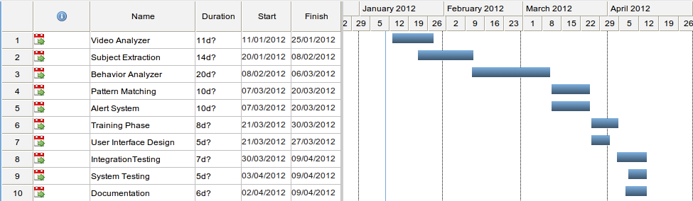
Gantt Chart

Slide 18
REFERENCES
[1] T. Moeslund, A. Hilton, and V. Kruger, “A Survey of Advances in Vision-Based Human Motion Capture and Analysis,” Computer Vision and Image Understanding, vol. 103, nos. 2-3, pp. 90-126, Nov. 2006.
[2] L. Wang, W. Hu, and T. Tan, “Recent Developments in Human Motion Analysis,” Pattern Recognition, vol. 36, no. 3, pp. 585-601, Mar. 2003.
[3] A. Bobick and J. Davis, “The Recognition of Human Movement Using Temporal Templates,” IEEE Trans. Pattern Analysis and Machine Intelligence, vol. 23, no. 3, pp. 257-267, Mar. 2001.
[4] D. Weinland, R. Ronfard, and E. Boyer, “Free Viewpoint Action Recognition Using Motion History Volumes,” Computer Vision and Image Understanding, vol. 103, nos. 2-3, pp. 249-257, Nov. 2006.
[5] T. Syeda-Mahmood, M. Vasilescu, and S. Sethi, “Recognizing Action Events from Multiple Viewpoints,” Proc. IEEE Workshop Detection and Recognition of Events in Video, pp. 64-72, 2001.

